Slide 1

Supply Chain Management Dashboard
Presented by Kammampati Saivamshi. This dashboard analyzes supply chain performance using real-time operational data.

Slide 2
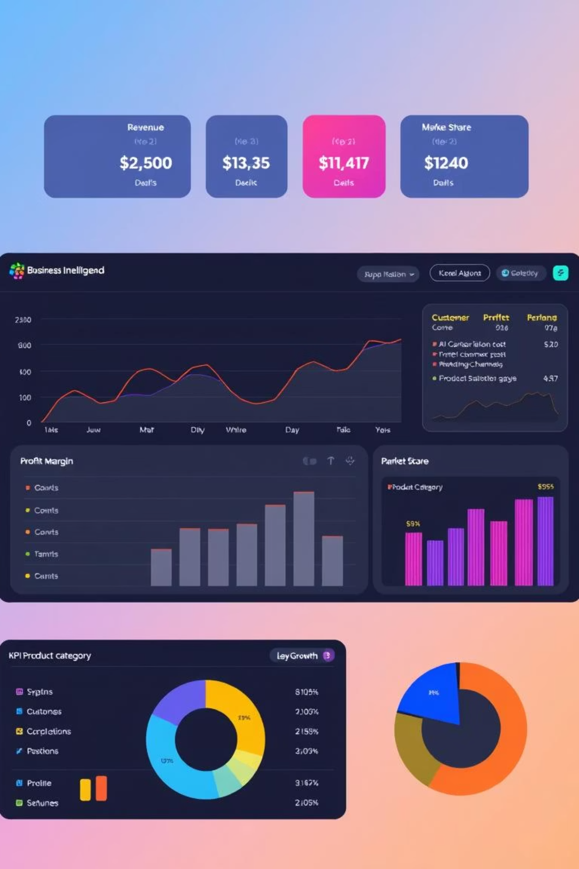
Project Objective
Analyze Performance
Evaluate inventory, cost, delivery delays, defect rates, and efficiency.
Enable Decisions
Support data-driven optimization for production, warehousing, and delivery.
Key focus:
Inventory, cost, delivery delays, defect rates, and efficiency

Slide 3





Tools & Technologies
Power BI
Used for dashboard creation and data visualization.
Excel / CSV
Primary data source for the dashboard.
DAX & Power Query
For KPI logic and data transformation.
Python
For data preprocessing and exploratory analysis.

Slide 4

Dataset Overview
The dataset is from a file named SUPPLY_CHAIN.csv.
It contains 100 rows and 35 columns.
Key columns include product type, SKU, price, and revenue.
Additional key columns cover shipping times, defect rates, and various costs.

Slide 5

Data Preparation & Cleaning
Missing Values
Data Types
All columns were handled with no missing values.
Corrected data types for delivery and cost fields.
KPI Generation
Field Cleaning
Generated KPIs using calculated columns in Power BI.
Cleaned SKU, inspection results, and supplier names for uniform analysis.

Slide 6
Dashboard Visual Overview
KPI Cards
Charts & Graphs
Production volume
Revenue by Product Type (Bar Chart)
Order Quantities
Delivery Time vs Time Period (Line Chart)
Avg Defect Rate
On-Time vs Delayed Deliveries (Pie Chart)
Total Revenue
Inventory, Shipping & Defect Analysis (Table)
Slicers allow filtering by location, supplier, and product type.

Slide 7
Key Performance Indicators
₹5,77,604
57000
23.7
4922
Total Revenue
Production Volume
Avg Delivery Time
Order Quantities
Approximate sum of revenue generated.
Total units produced.
Average delivery time in days.
Total number of orders.
4840
9554
Units Availability
Stock Levels
Available units in stock.
Current inventory stock levels.

Slide 8
Insights & Recommendations
Key Findings
Recommendations
Haircare has higher revenue than skincare.
Increase inspection for high-defect suppliers.
Carrier C has lower delays despite less frequent use.
Optimize routes for faster delivery.
Improve inventory planning.
Mumbai handles most orders but has higher defect costs.
Switch from high-cost carriers for low-priority.
SKU3 and SKU4 show high defective inventory.

Slide 9
Conclusion
Dashboard helps supply chain managers understand operational bottlenecks
Visuals provide actionable KPIs for logistics, production, and inventory teams
With minor optimizations, delivery time & defect costs can be reduced significantly

